Slide 1
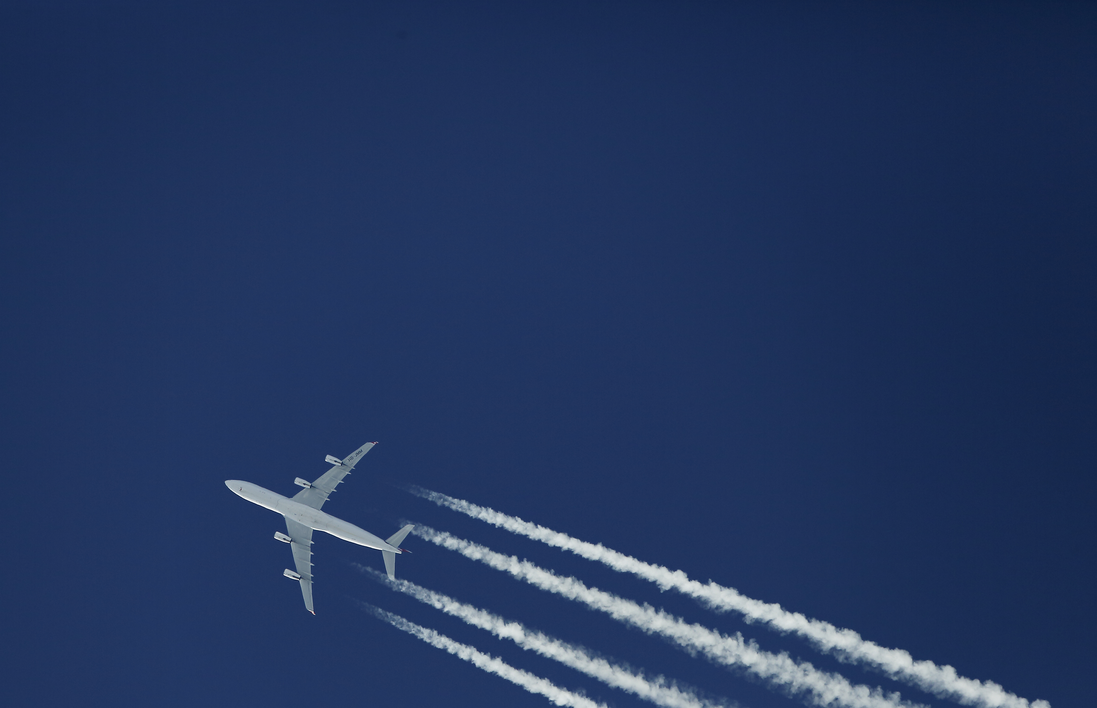
FLIGHT DELAY
PREDICTION
Grace Pham, Heidi Tran, Jessica Jha, Khanh Tran

Slide 2

Problem statement
People fly every day and delays happen everyday.
We hope to uncover certain trends from this data such
as which airlines have the most delays
which destinations are most impacted
what are the causes of these delays
how often delays occur
build predictive classification models and compare which one can predict flight delays the best

Slide 3

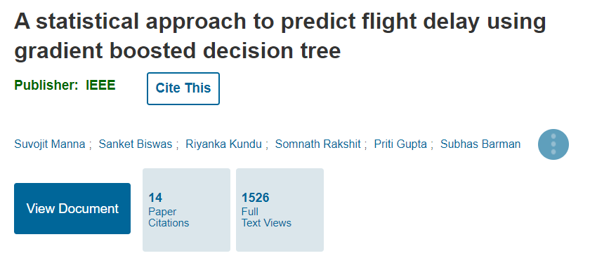
Relevant work
Source: S. Manna, S. Biswas, R. Kundu, S. Rakshit, P. Gupta and S. Barman, "A statistical approach to predict flight delay using gradient boosted decision tree," 2017 International Conference on Computational Intelligence in Data Science(ICCIDS), 2017, pp. 1-5, doi: 10.1109/ICCIDS.2017.8272656.
Source: The Verge 2018
Notes:
For relevance, this area is being highly researched by industry professionals and large companies since this topic affects every day life, not just passengers who fly commericially, but the airport crew and staff , families of passengers, and extending to cargo and supply chain problems which can adverssely affect a wide range of fields from healthcare, tech, and agriculture.

Slide 4
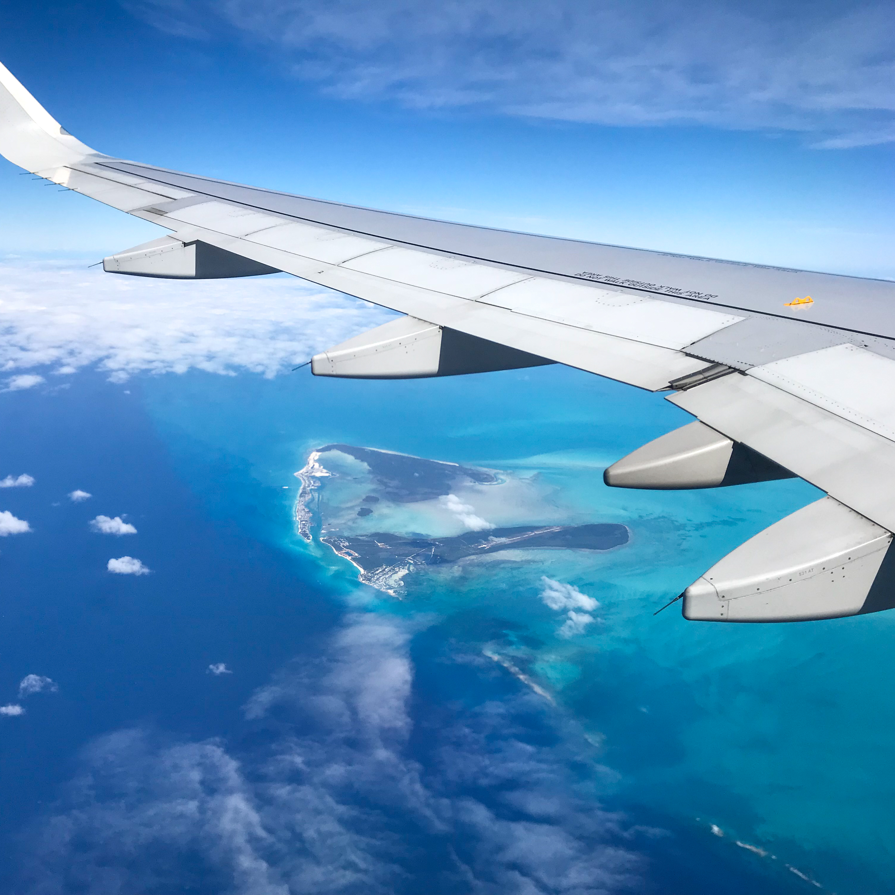
data
Source: U.S. Department of Transportation Bureau of Transportation Statistics through IBM Developer Website
CSV format
194 million flights -> ~386,000+ records and 109 rows

Slide 5

DATA Pre-Processing

Slide 6

Downsizing the data
Full dataset: 7.2 GB → require a lot of computing power to process
Data covers dated back to 1987 → stale data can harm the model
Cut down the data with Spark
New dataset
Data coverage: 2014 – 2019
Size: ~200MB

Slide 7


Pre-processing columns
Removed columns
Redundant information
Unnecessary
Added new columns that help future analysis
Renamed columns for ease of use
Checked for duplicated records
Checked for missing values
Drop columns with > 95% missing values
Filled missing data for numeric columns
Dropped rows with missing categorical data
Checked for outliers → keep outliers

Slide 8
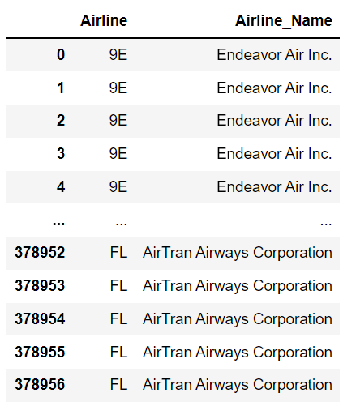
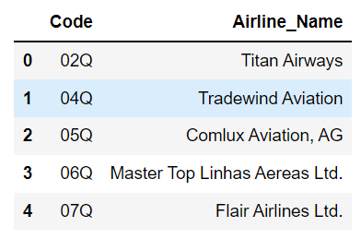


Map airline codes to their names
Airline Mapping

Slide 9

Exploratory data analysis

Slide 10
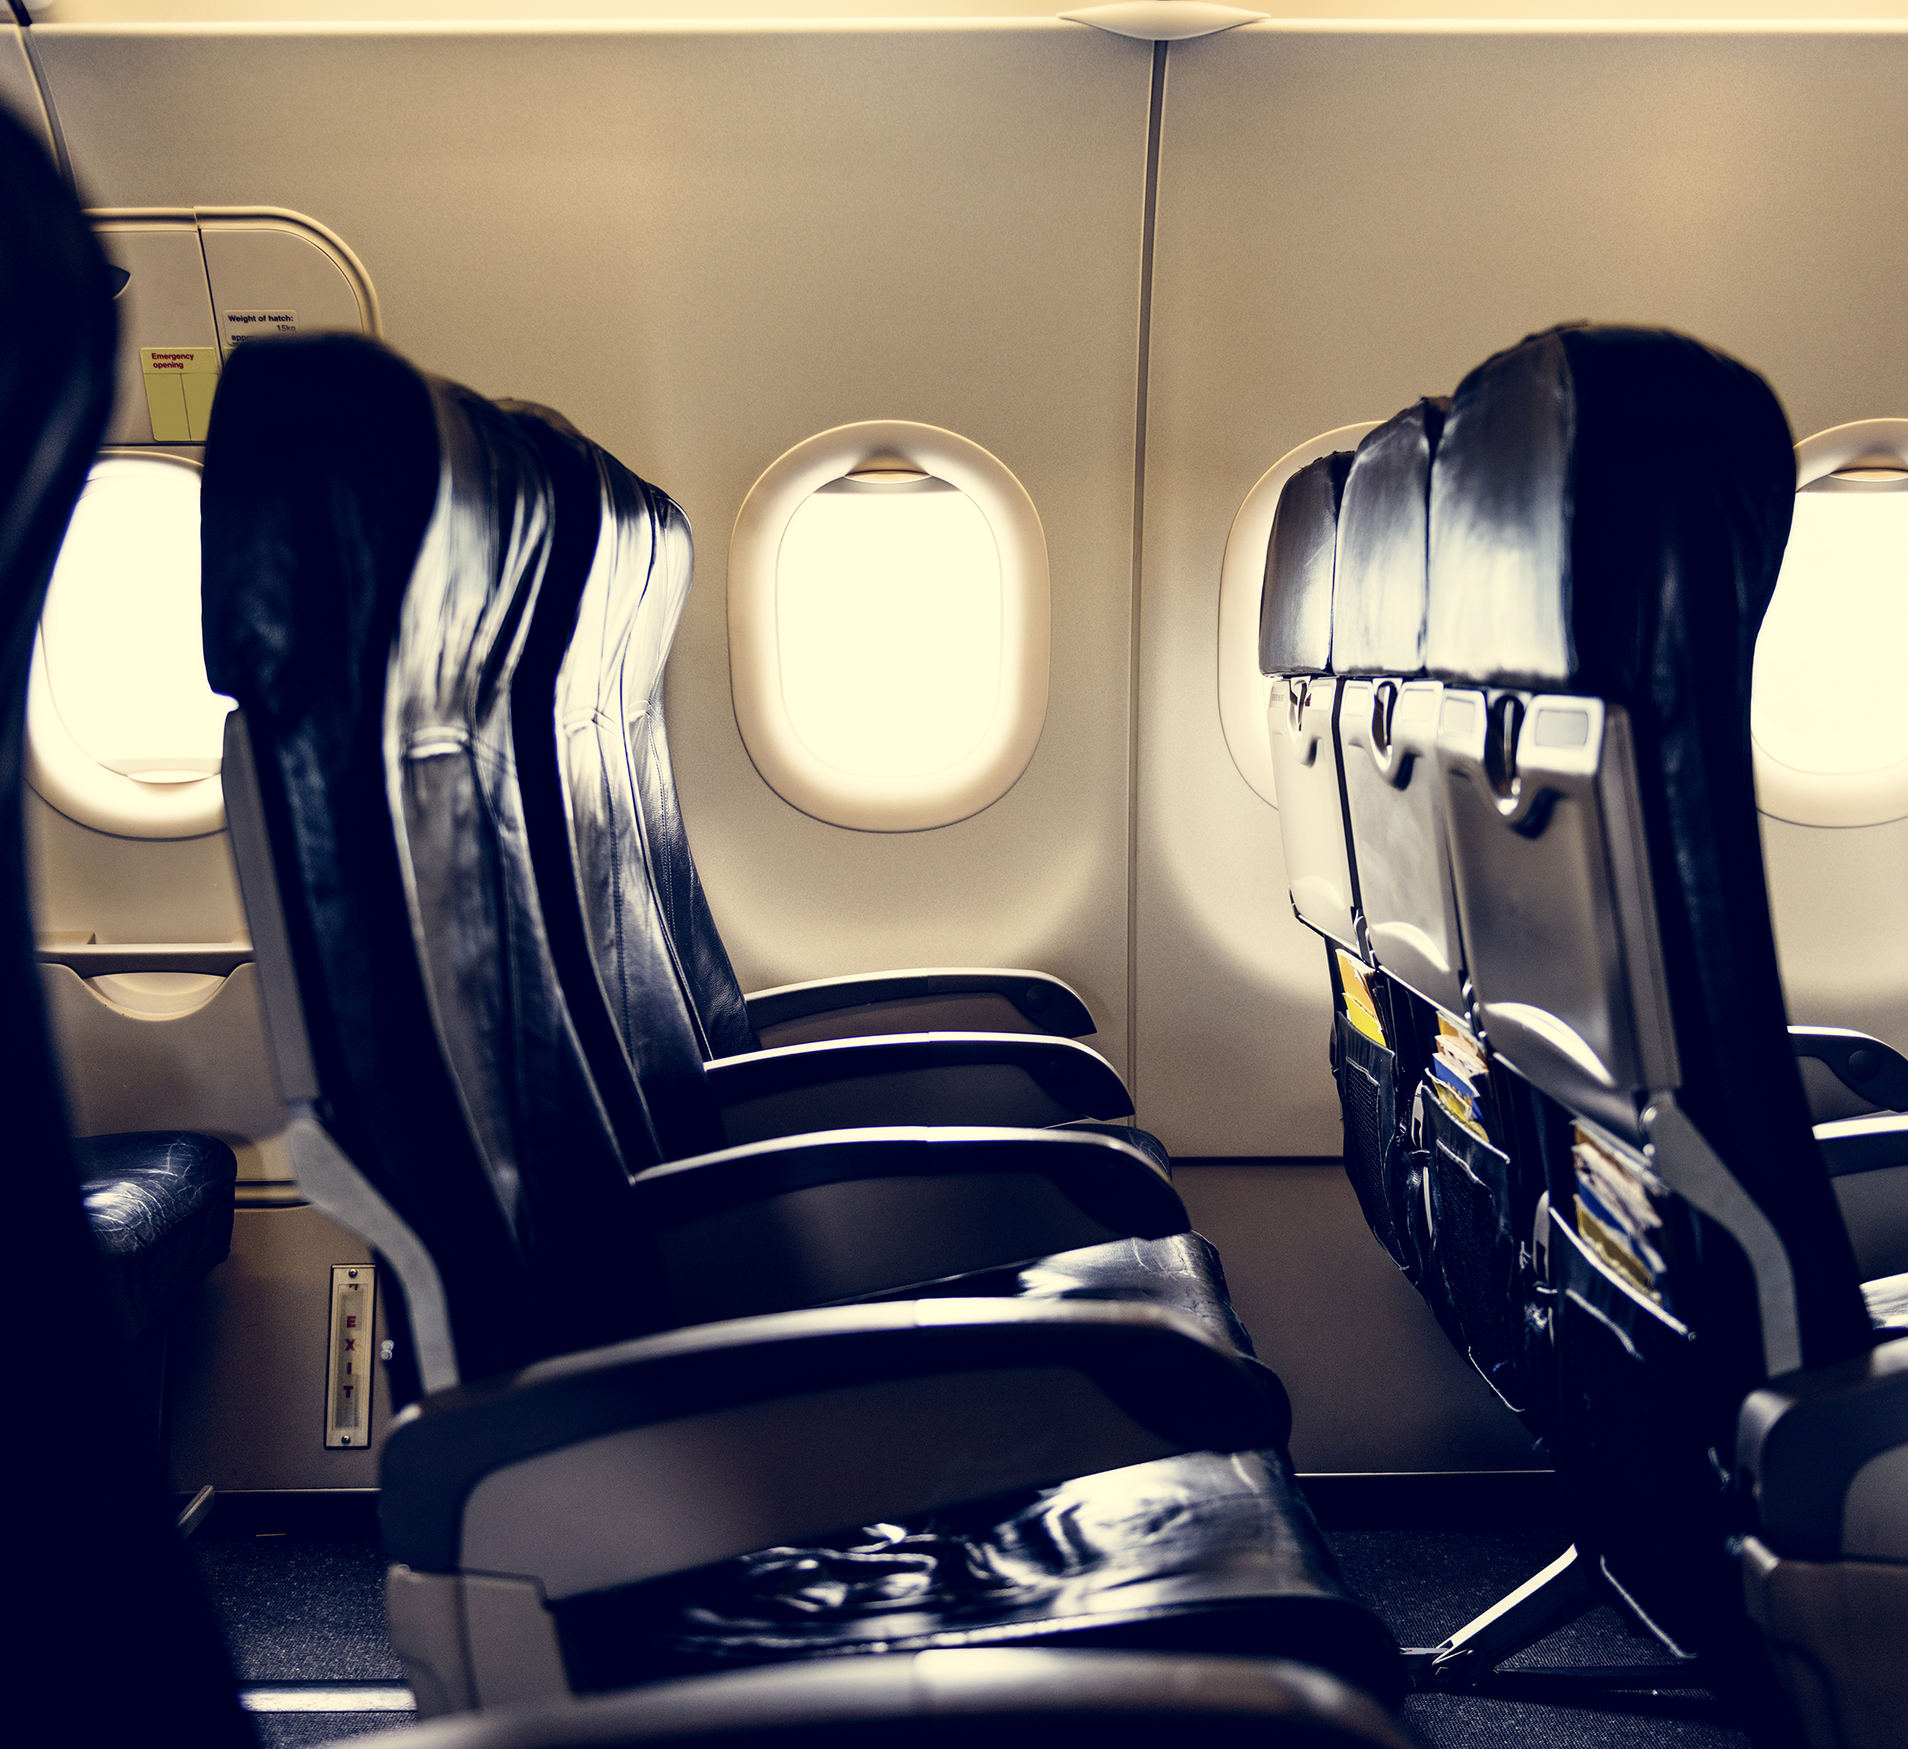
overview
36.01% of flights delayed on departure
36.29% of flights delayed on arrival
Mean departure delay is 13 minutes
Max departure delay is 31.3 hour

Slide 11
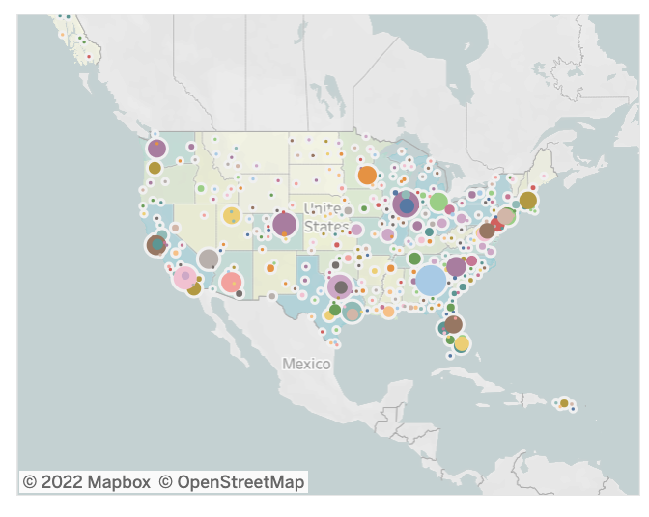
Airports with highest number of delays
Condensed in major U.S. cities:
Atlanta, Georgia
Chicago, Illinois
Denver, Colorado
Phoenix, Arizona
L.A. and S.F. California
Las Vegas, Nevada
Dallas-Fort Worth and Houston, Texas
New York City, New York
Newark, New Jersey
https://public.tableau.com/app/profile/j.jha/viz/Info442-Maps/Story1

Slide 12
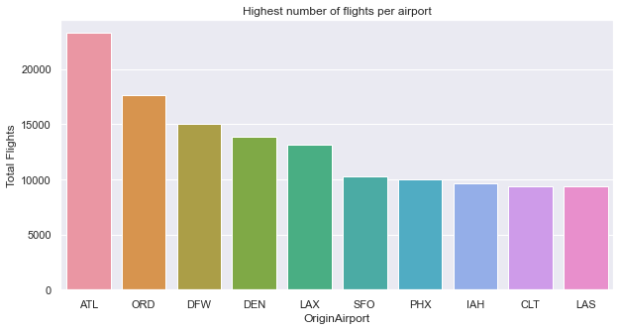
Airports with highest number of flights
https://www.cnn.com/travel/article/worlds-busiest-airports-2021/index.html
https://usabynumbers.com/busiest-airports-in-the-us/

Slide 13
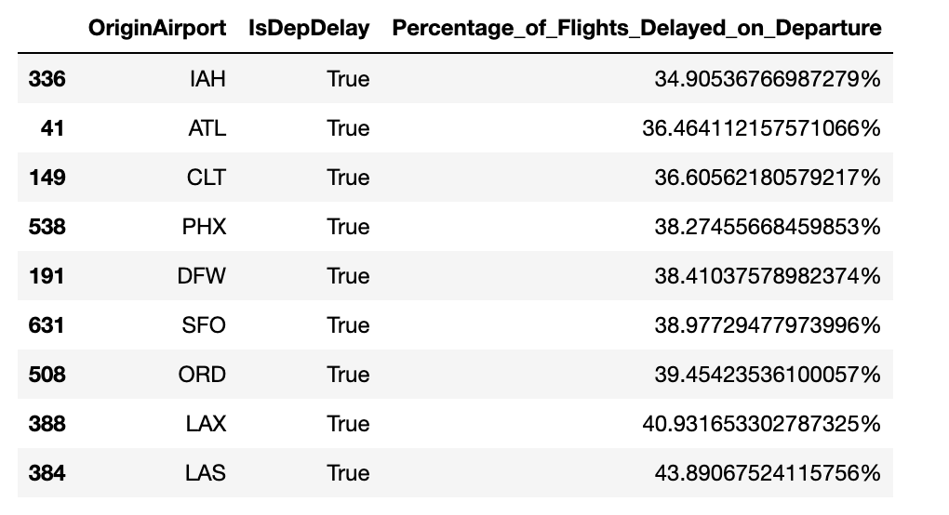
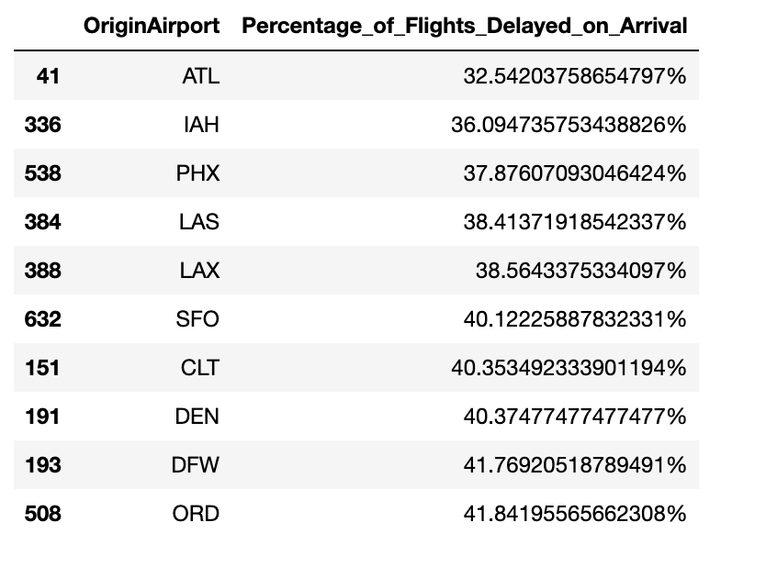
Airports with least -> most frequent delays

Slide 14
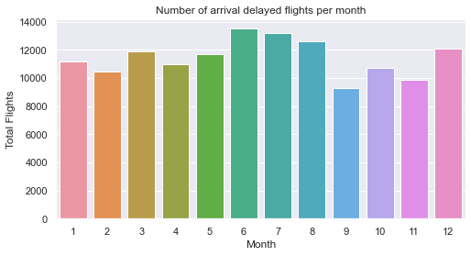
Months Most Delayed
Notes:
The highest amount of delays occur during the summer months where families are off from school and work and in December with the holiday season bringing in more air travelers.

Slide 15
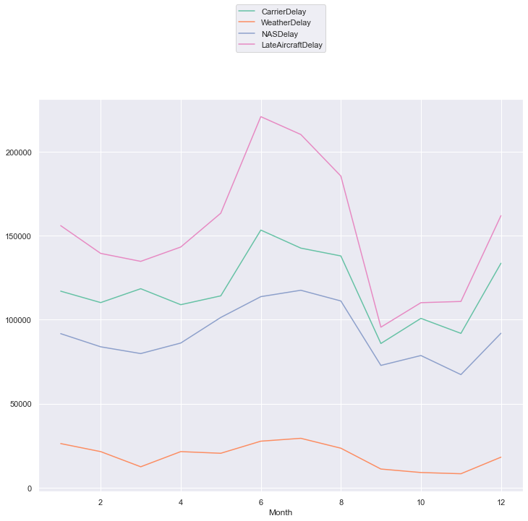
Specific Delayed factors
Air Carrier: The cause of the cancellation or delay was due to circumstances within the airline's control (e.g. maintenance or crew problems, aircraft cleaning, baggage loading, fueling, etc.).
Extreme Weather: Significant meteorological conditions (actual or forecasted) that, in the judgment of the carrier, delays or prevents the operation of a flight such as tornado, blizzard or hurricane.
National Aviation System (NAS): Delays and cancellations attributable to the national aviation system that refer to a broad set of conditions, such as non-extreme weather conditions, airport operations, heavy traffic volume, and air traffic control.
Late-arriving aircraft: A previous flight with same aircraft arrived late, causing the present flight to depart late – fun fact this is called delay propagation in the aviation world
Understanding the Reporting of Causes of Flight Delays and Cancellations | Bureau of Transportation Statistics (bts.gov)
Notes:
Continuing with seaosonal data, we assumed that the winter months might have significant more delays because of winter storms in many parts of the country, and we can see the uptick in December and January. But we can also see that more weather-related delays were during the summer months, possibly due to severe summer thunderstorms across the US or tornadoes in the mid-west. The delays that are heavily recorded come from Late Aircrafts – meaning that a previous or connecting flight was late, and set off a dominoe affect (also known as delay propogation in the aviation world). Followed that are delays by the aircraft carrier, which means there were Maintenace, cleaning, baggage loading/unloading, or crew problems that caused a cancellation or delay. And the other highly recorded factor shown (the purple line) are delays by NAS, the national aviation system, which includes airport operations and air traffic control problems or non-extreme weather, sort of like a catch-all category.

Slide 16
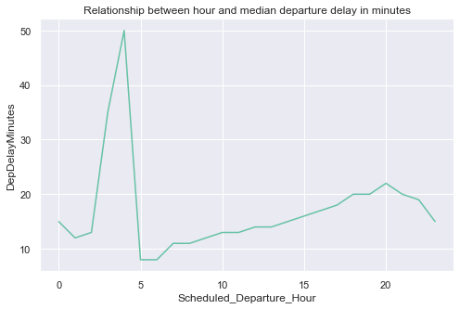
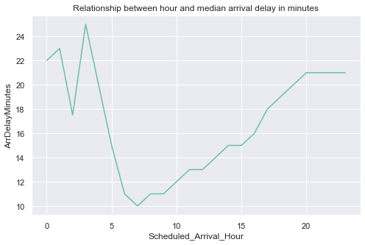
Time of Day most Delayed
Departure
Arrival
Notes:
From this dataset we saw that median departure delays were close to an hour and occurred between 3-5am. And for arrival, the median arrival delay was half of that, closer to 26 minutes around 3am, and then gradually rose throughout the day.

Slide 17
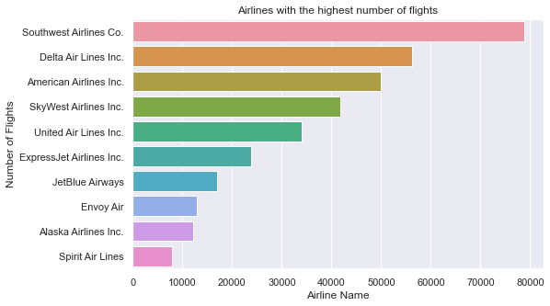
Airlines with highest number of flights
Notes:
Moving into specific airlines, Southwest, Delta, and American service the most flights within the US

Slide 18
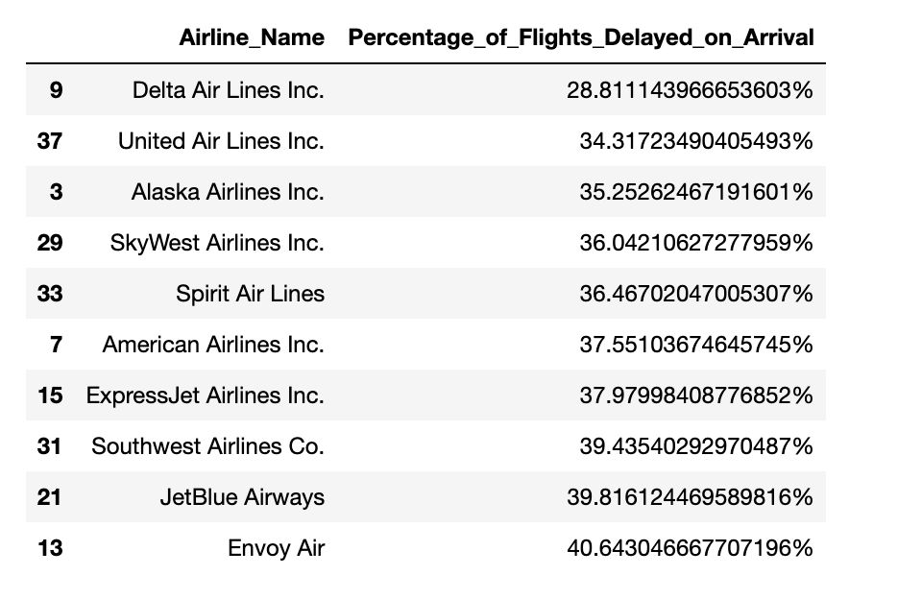
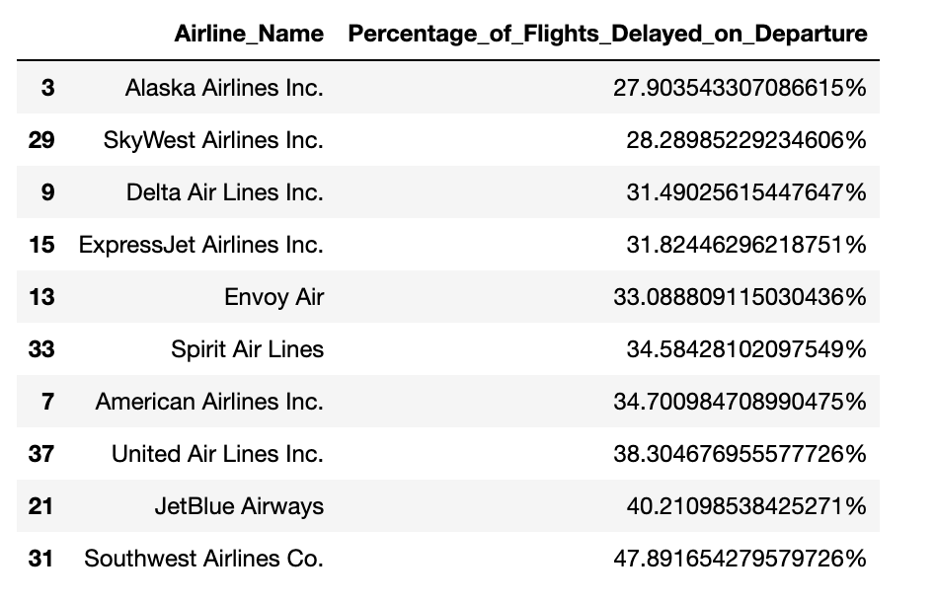
Airlines with least -> most frequent departure/arrival delay
Arrival: Envoy, JetBlue, Southwest
Departure: Southwest, JetBlue, United
Notes:
And although Delta serves some of the most flights, it has one of the lower percentage of flights to be delayed at only 28% of their flights compared to Envoy or JetBlue or Southwest whose flights delay 40% of the time. For departure Southwest flights delay almost half of the time followed by JetBlue and United, while Delta, SkyWest, and Alaska Airlines are under 32% for departure delays likeliness.

Slide 19

Modeling

Slide 20
Feature Selection
7 Categorical features
7 Numerical features
Airline​
Origin State​
Destination State​
Origin Airport​
Destination Airport ​
Origin City
Destination City
Year
Month
Day
Taxi In
Taxi Out
Wheels Off
Wheels On

Slide 21
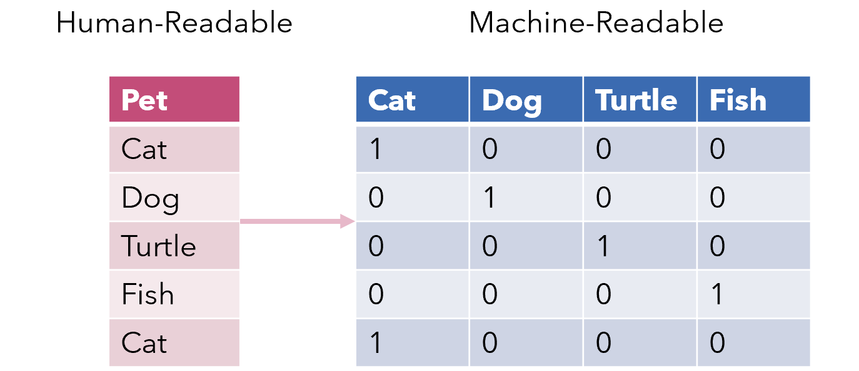
Encoding categorical data
Origin and Destination data must have the same encoded values
→ use the same encoder for two columns
Used LabelEncoder convert each categorical value into a number
OneHotEncoder convert each value into a new column of 0s and 1s
Notes:
(for example JFK must be the same value in Destination Airport as in Origin Airport column)

Slide 22
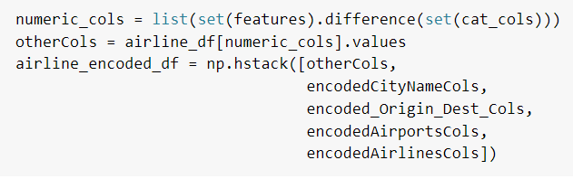
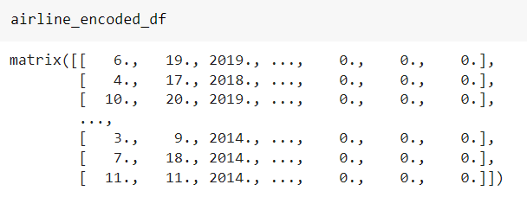
New dataframe for modeling
Combining the features columns and columns after encoded, we construct a new data frame to run models on.
► airline_encoded_df
Notes:
(for example JFK must be the same value in Destination Airport as in Origin Airport column)

Slide 23
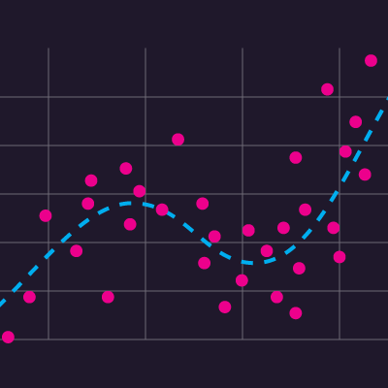
Regression
Linear Regression & Decision Tree

Slide 24
Linear Regression
Target variable: DepDelayMinutes
Independent variables: 14 attributes mentioned above, including 7 encoded variables.
Results:
Mean Squared Error (MSE): 1637.96
Coefficient of determination: 1.00
Root Mean Squared Error (RMSE): 40.47

Slide 25
Linear Regression
➤ The RMSE score (40.91%) shows that the average distance between the observed data values and the predicted data values is large. This model was not doing well in fitting the dataset
➤ With an R-squared score of 1.00, the model is indicated to be a perfect model where the fitting line fits perfectly with the data points. This contradicts the positive MSE.
➤ Plotting is not possible due to the difference between the shape of the independent variables and dependent variable. The lack of visualization is considered a big downsize of this approach.
➤ This is not an ideal approach.

Slide 26
Decision Tree
Target variable: DepDelayMinutes
Independent variables: 14 attributes mentioned above, including 7 encoded variables.
Max depths: 2 and 5
Results:
 | Max depth = 2 | Max depth = 5
MSE | 1578.20 | 1578.20
R² | 1.00 | 1.00

Slide 27
Decision Tree
Again, we witness the same issue with the MSE and R² score pair as the one in the linear regression analysis above.
➤ This is not an ideal approach.

Slide 28

Challenge with regression models
One-hot encoding explodes the 7 categorical decision variables into a massive matrix of numerical values, which prevents regression models from fitting the training data efficiently.
Visualization is not viable.
➤ With half of the attributes being categorical, it is more reasonable to go for classification models.

Slide 29
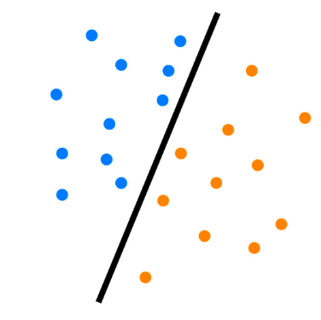
Classification
Decision tree & Random forest

Slide 30
Create a binary label columns for classification

Slide 31
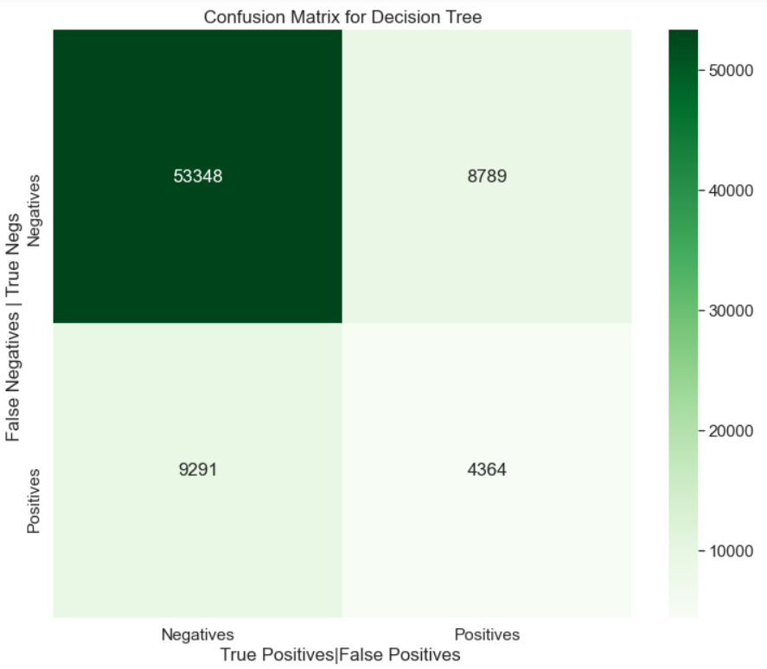
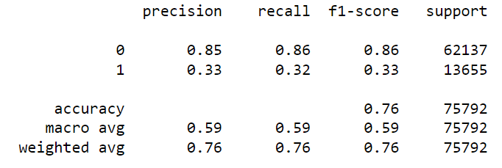
Decision Tree
- Model accuracy is 76%.
- F-1 score for the positive label is around 33% which is very low
→ High occurrence of False Negative in prediction: Lots of flights with less than 15 minutes delay were classified as having more than 15 minutes delay
Reason: Highly skewed data (more flights with shorter delay time than flights with long delay time)
→ Our approach: Use oversampling:
Randomly selected examples from the minority class (high delay time) and added them to the training dataset
Dataset becomes more balanced

Slide 32
Over sampling with SMOTE
Data is skewed → Over-sampled the positive class in training data

Slide 33
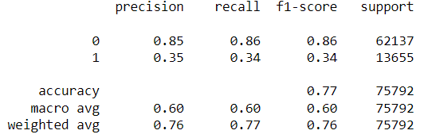
Decision Tree with Over Sampling
- Model accuracy is 77% (an 1% increase)
- F-1 score for the negative label is around 86% (unchanged)
- F-1 score for the positive label is around 34% (an 1% increase)
→ This is not a considerable increase from F-1 score before oversampling
→ This model's still not doing well after oversampling approach

Slide 34
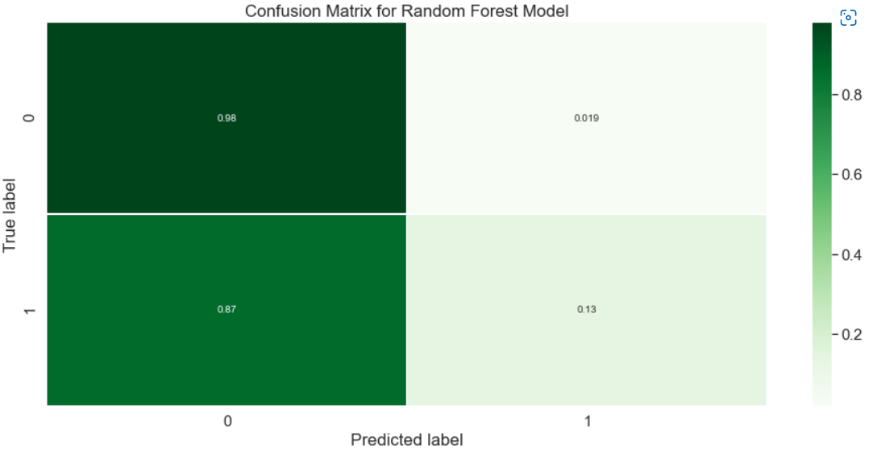
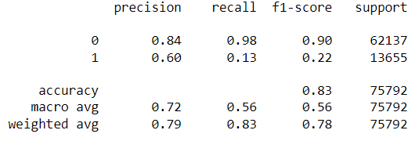
Random Forest with Over Sampling
Decent accuracy score: 82.8%
F-1 score for the positive label is around 22%
F-1 score for the negative label is around 90%
Decent Weighted F-1 score: 78%

Slide 35
Comparison
DECISION TREE
1
Decent accuracy score: 82.8%
F-1 score for the negative label is around 90%
F-1 score for the negative label is around 90%
Decent Weighted F-1 score: 78%
Decent accuracy score: 77%
F-1 score for the negative label is around 86%
F-1 score for the positive label is around 34%
Average Weighted F-1 score: 60%
RANDOM FOREST
2
Performances are similar: Random Forest is better with Accuracy Score, and Decision Tree has higher F-1 score

Slide 36

Outcomes & impacts

Slide 37
Steps to increase model performance
Penalizing the model - imposes an additional cost on the model for making classification mistakes on the minority class during training
Hyper-parameter tuning using gridsearch, randomSearch, Optuna, XGBoost, or Bayesian Optimization; Using Undersampling together with Oversampling
Re-analyzing data download/processing methods & examine feature importance
Utilizing cloud clusters to work with more complete datasets
https://machinelearningmastery.com/tactics-to-combat-imbalanced-classes-in-your-machine-learning-dataset/

Slide 38
Conclusions
EDA:
Southwest and JetBlue has the most frequent delays
Las Vegas and Chicago has the highest delay rate
average of 36% of all flights are delayed
Modeling:
Classification preferred over regression
Utilizing SMOTE negatively impacted our models
Decision Trees performed (comparatively) well to Random Forest
Notes:
To wrap up, we learned that
The results may benefit passengers to help plan their next itineraries and prepare the best plan of action to make sure their flights to their destination are as delay-free as possible.
(Synthetic Minority Oversampling Technique)
In addition, our team also learned a lot about what we do and do not know about various tach stacks utilized throughout the

Slide 39
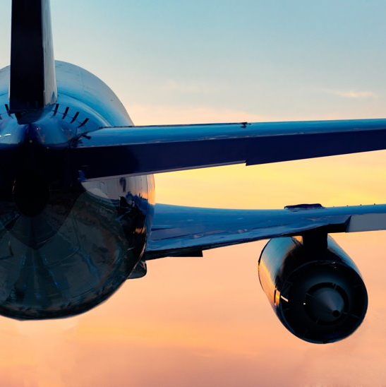
Thank you
Any questions/comments/concerns?

